Slide 1
Exploring the Starbucks Drink Menu
Which drinks are the ‘healthiest’?

Slide 2
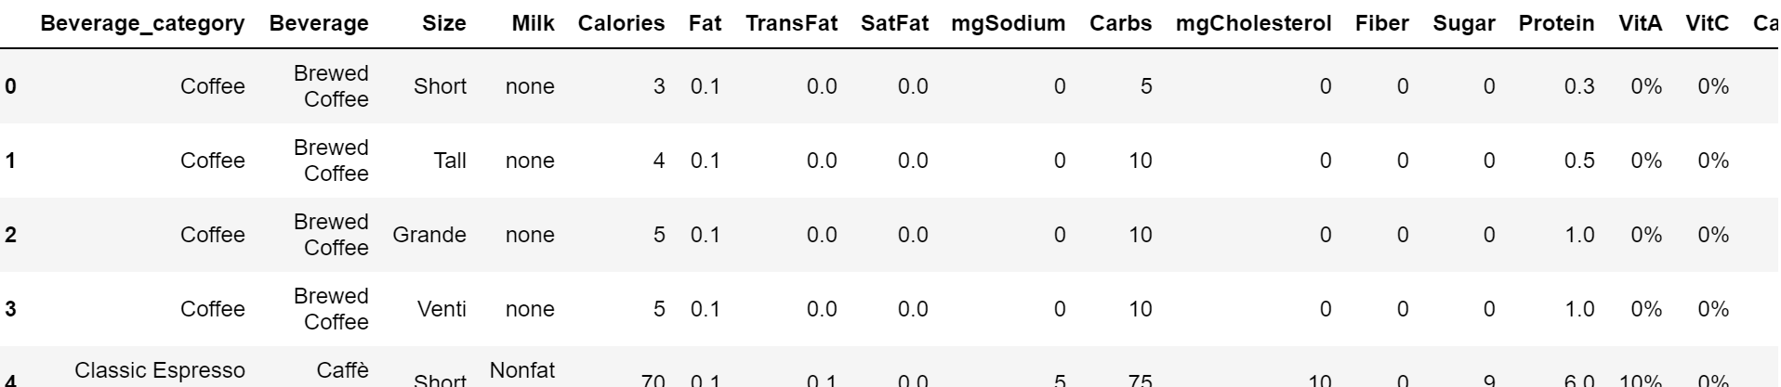
A glance at the data…

Slide 3
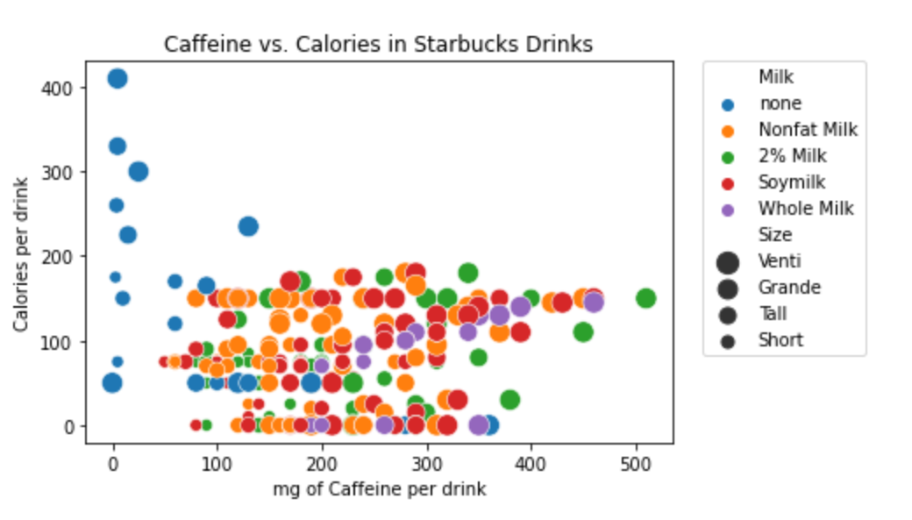
What if I want the most caffeine?

Slide 4
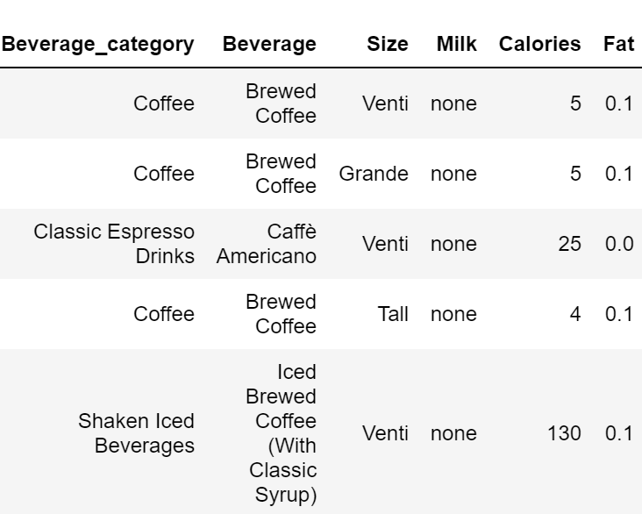
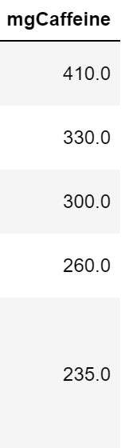
Plain coffee or espresso have the most
caffeine, and some of the fewest calories.

Slide 5
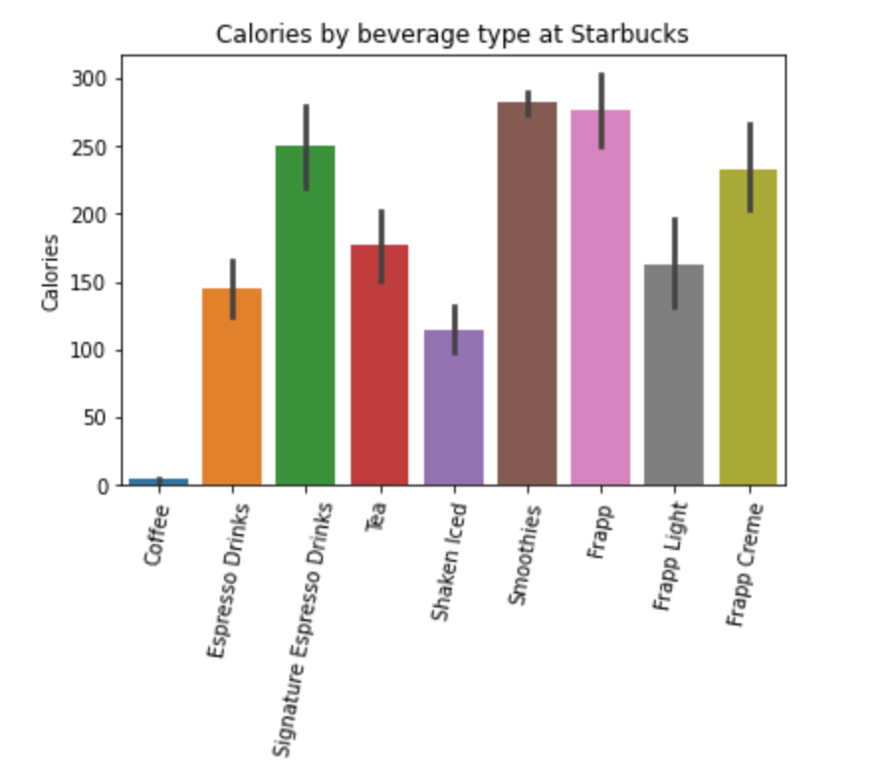
Coffee, espresso, or shaken iced tea
drinks are your best bet for fewest calories
(regardless of size)

Slide 6
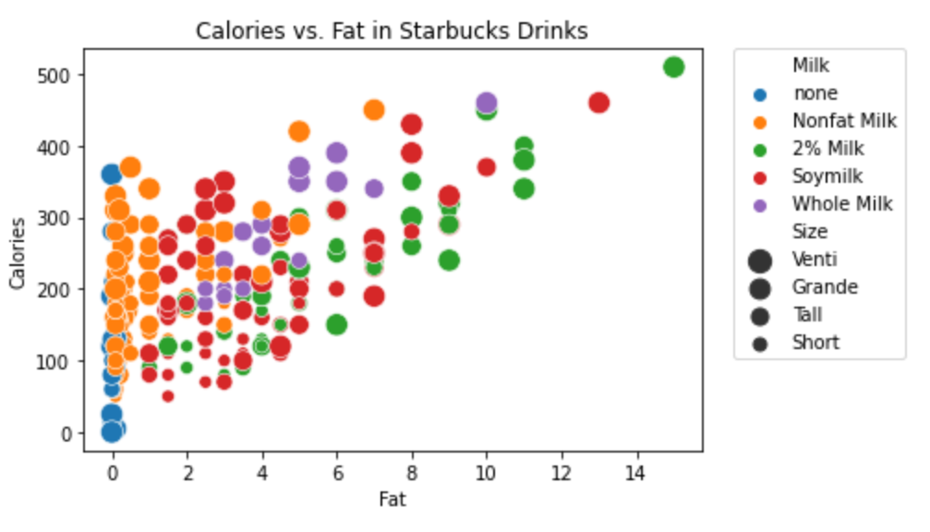
Where do the calories come from?
Positive correlation with fat content

Slide 7
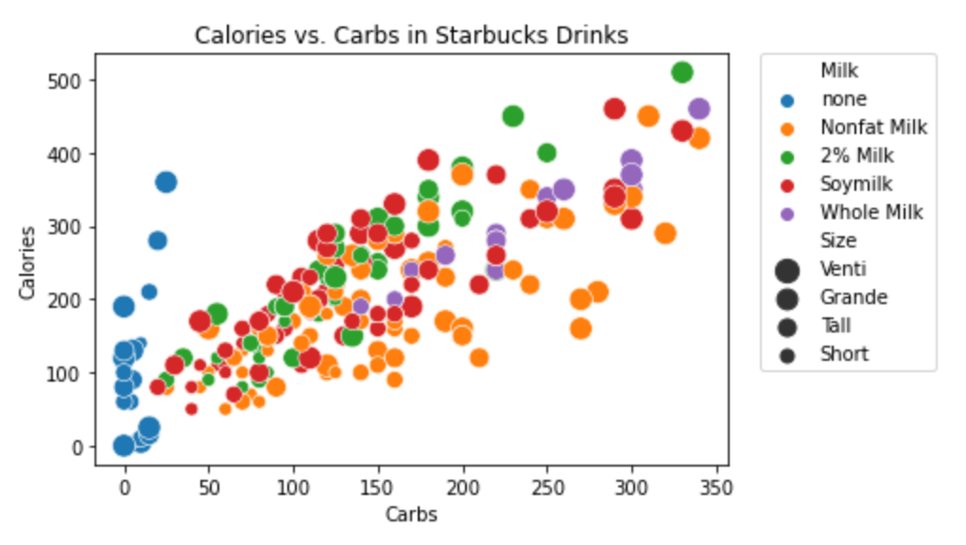
Where do the calories come from?
Slightly stronger correlation to carbohydrates

Slide 8
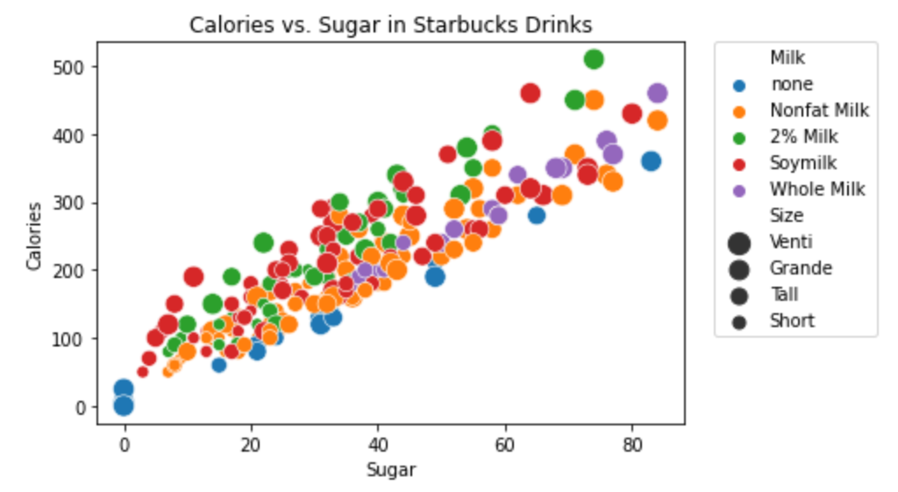
Where do the calories come from?
Strongest correlation with sugar content

Slide 9
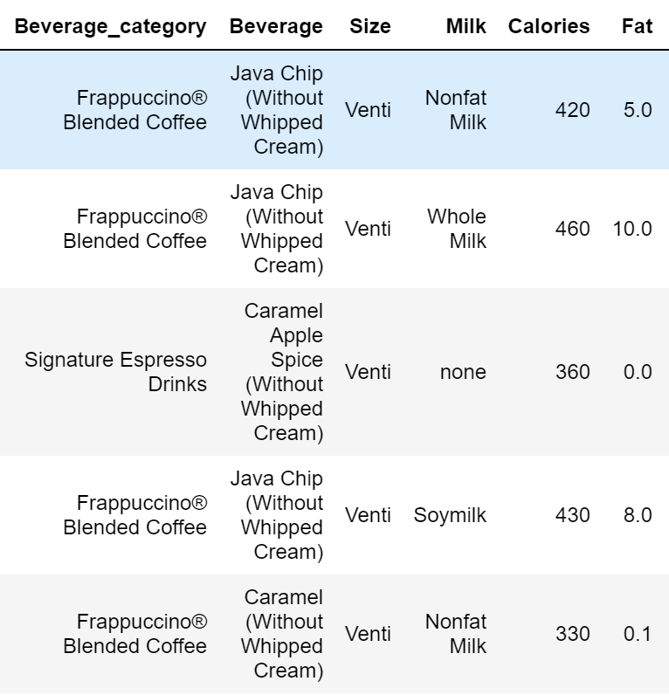

Top 5 drinks with the most sugar:

Slide 10
A few interesting things…

Slide 11
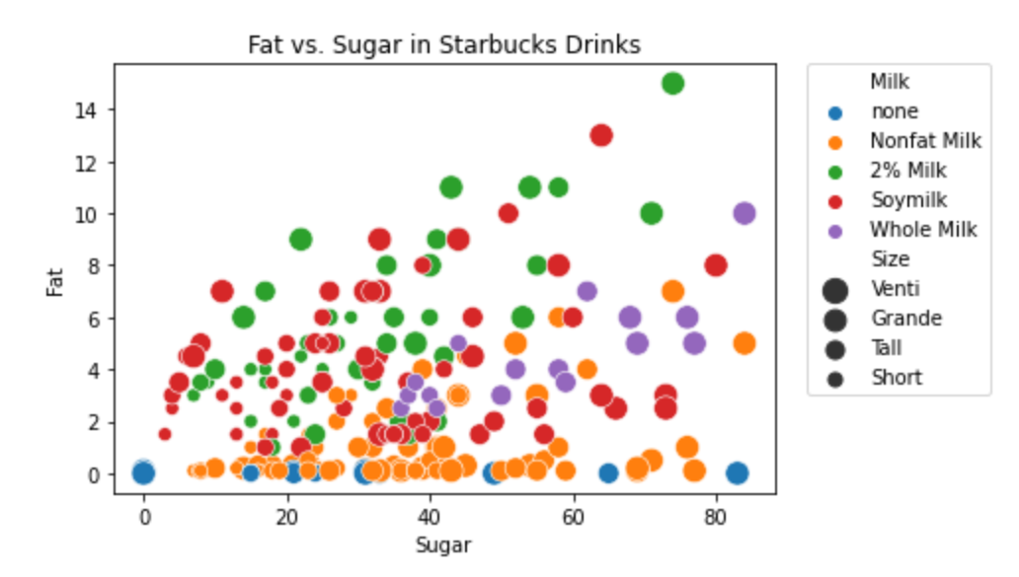
Very little correlation between fat and sugar content

Slide 12
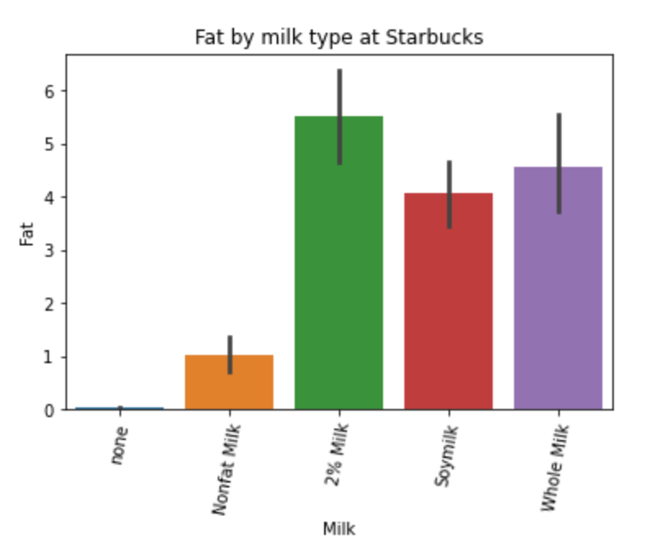
Whole milk drinks do not necessarily have the most fat

Slide 13
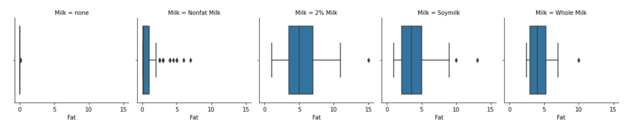
Average fat content, regardless of milk, is around 5 grams

Slide 14
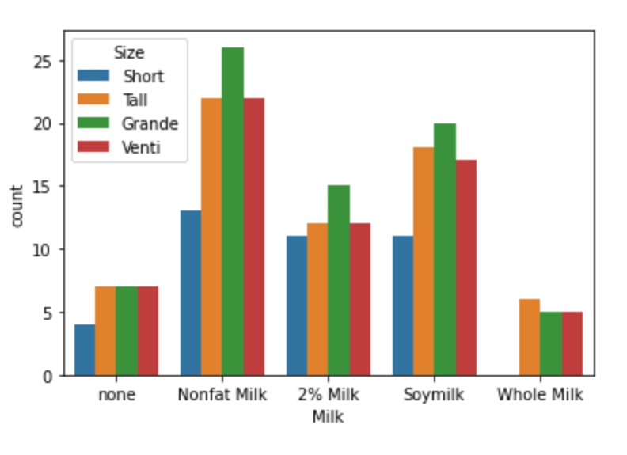
There are over twice as many 2% milk and soymilk drink options. Maybe this is where variation comes from.

Slide 15
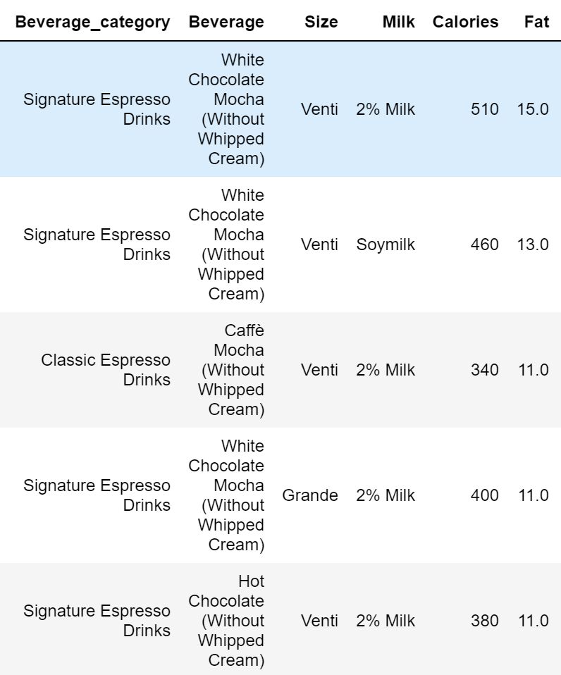
The drinks with the most fat are all mocha drinks, where you get additional fat from the chocolate.

